Slide 1
Job Seeking Application
Vijay Srinivas K(158)
Vishal Sairam(163)
Tarun R(148)

Slide 2
Contents
Problem Statement
1
Further Exploration
2
Problem Analysis
3
Structure Chart
4
Architecture Diagram
5

Slide 3
Module description
6
Implementation
7
Limitations
8
Observations
9
Learning Outcomes
10

Slide 4
Problem statement
Develop a platform that connects job seekers with relevant job positions and helps talent acquisition managers find suitable applicants. Constraints are defined for each job seeker and job position, and recommendations are made based on the degree of constraint satisfaction. The recommendation percentage is calculated by weighting and scoring the satisfying constraints compared to all available constraints.

Slide 5
Further exploration
1. User Profiles: The platform needs to allow job seekers to create detailed profiles that include their skills, qualifications, work experience, education, and any other relevant information. This will enable the platform to match job seekers with suitable job positions based on their profiles. Additionally, talent acquisition managers should have the ability to create profiles for their companies or organizations.
2. Job Listings: The platform should provide a comprehensive database of job listings from various companies and organizations. These listings should include information about the job title, required qualifications, experience level, location, and any other specific requirements. Job seekers should be able to search and filter these listings based on their preferences and receive notifications about new job openings that match their profiles.
3. Matching Algorithm: To facilitate effective matches between job seekers and job positions, a robust matching algorithm should be implemented. This algorithm should take into account various factors such as skills, qualifications, experience, location, and preferences of both job seekers and talent acquisition managers. The algorithm should prioritize the most relevant and compatible matches, improving the chances of successful recruitment

Slide 6
Further exploration
4. Feedback and Reviews: Job seekers should have the opportunity to provide feedback and reviews about their experiences with the platform and specific companies or organizations. This feedback can help improve the platform's functionality and assist other job seekers in making informed decisions about potential job opportunities. Similarly, talent acquisition managers should be able to rate and provide feedback on applicants they have interacted with.
5. Privacy and Security: Given the sensitivity of personal information shared on such platforms, robust privacy and security measures should be in place. This includes secure user authentication, data encryption, and adherence to privacy regulations like GDPR. The platform should also provide options for users to control the visibility of their information and manage their privacy settings.
6. Continuous Improvement: To ensure the platform remains effective and relevant, regular updates and improvements should be made based on user feedback and changing industry dynamics. This can include adding new features, enhancing the matching algorithm, improving user experience, and staying up to date with emerging job market trends.

Slide 7
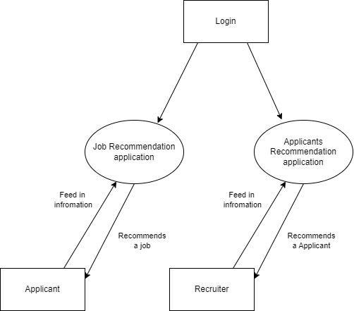
Problem Analysis DFD level 0

Slide 8
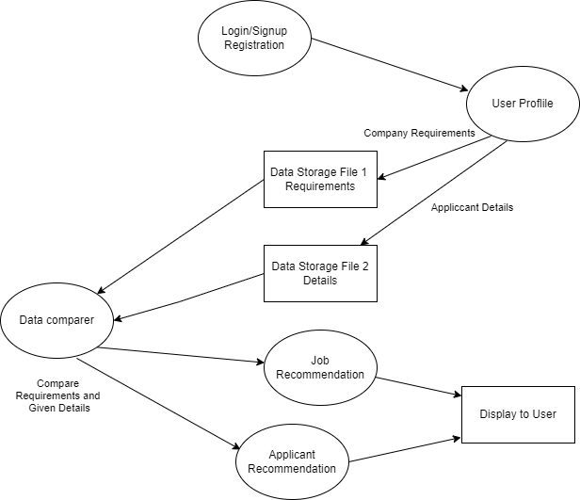
DFD level 1

Slide 9
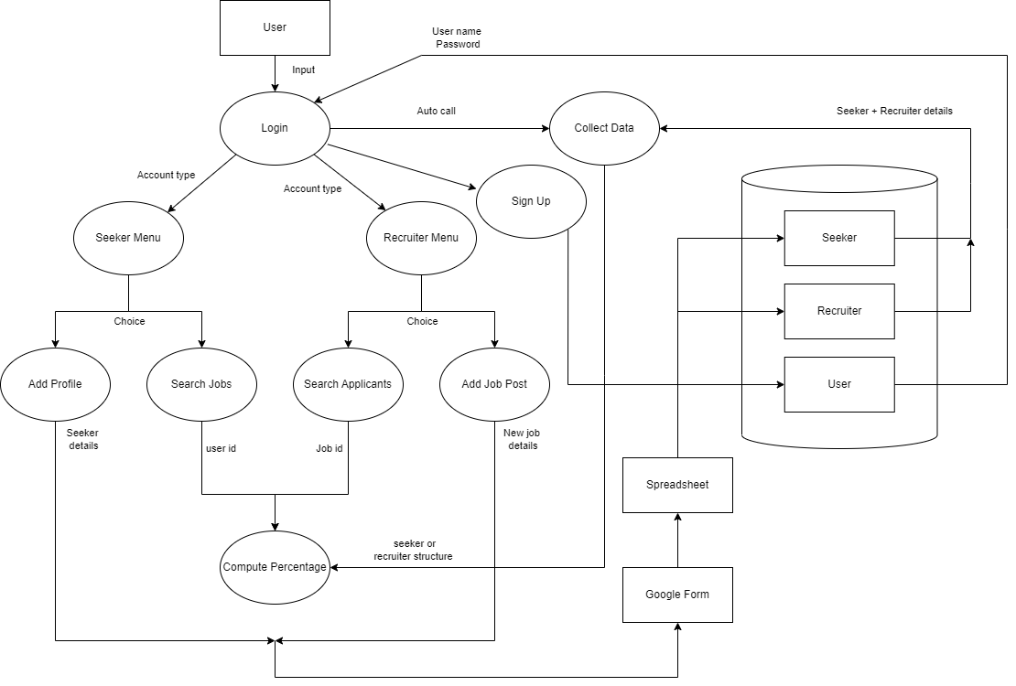
DFD level 2

Slide 10
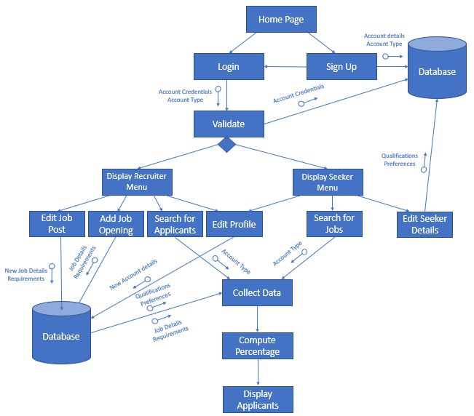
Structure Chart

Slide 11
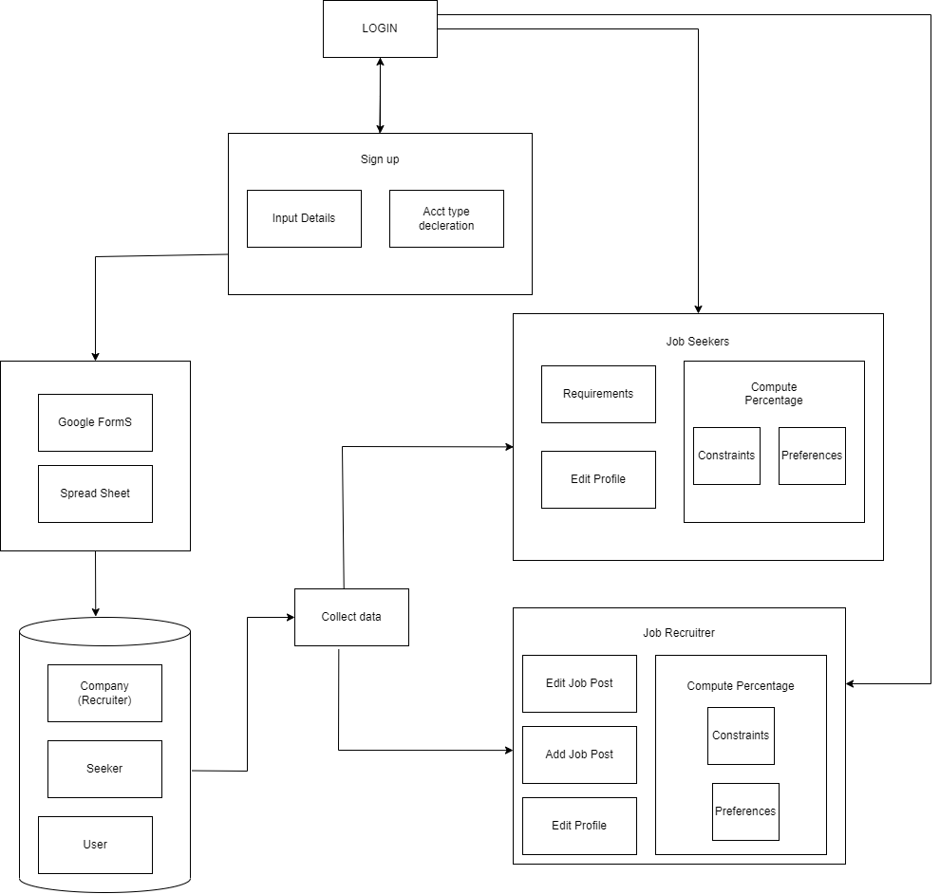
Architecture diagram

Slide 12
Module description
HOME PAGE MODULE: This module displays the home page of the application and allows the user to sign-up or login.
SIGN UP MODULE: This module allows the user to create a new account by creating a username and password, as well as entering information such as name, age, gender, date of birth, and account type. This information is stored in the User Profile Database.
LOGIN MODULE: The user is asked to input their username and password in this module.
VALIDATE MODULE: The entered username and password are verified by accessing the User Profile Database and searching for the corresponding credentials. If not found, a corresponding error message is displayed.
DISPLAY RECRUITER MENU MODULE:This module displays the various options present to the user if he/she has entered with a ‘recruiter’ account.
DISPLAY SEEKER MENU MODULE: This module displays the various options present to the user if he/she has entered with a ‘seeker’ account.
ADD JOB OPENING MODULE: Information about a particular job posting is to be inputted by the user. This includes Role Name, required qualifications, location, salary, years of experience, etc. This information is stored in the Job Recruiters Database.
EDIT JOB POST MODULE: This module is used to modify an already existing job opening created by the currently logged in account. The user may also be able to remove the posting entirely.

Slide 13
Module description
EDIT PROFILE MODULE: This module is common to both job recruiters as well as job seekers. It allows the user to edit their account information such as account username, password, and user personal info such as name and date of birth.
EDIT SEEKER DETAILS MODULE:A seeker may either provide their details or modify previously entered details using this module. This includes both details pertaining to the user’s resume and qualifications, or details specific to the user’s preferences.
SEARCH FOR APPLICANTS’ MODULE: It starts the process of displaying suitable job seekers by calling the Collect Data Module. It passes the account type to that function in order to specify which database is to be accessed and which data is to be displayed.
SEARCH FOR JOBS MODULE: It starts the process of displaying suitable jobs by calling the Collect Data Module. It passes the account type to that function in order to specify which database is to be accessed and which data is to be displayed.
COLLECT DATA MODULE: It starts by accessing both the Seekers and Recruiters Database and storing the information in a suitable data structure. This data is then passed to the Compute Percentage function.
COMPUTE PERCENTAGE MODULE: This Module computes the percentage by following a weighted average calculation. Each individual constraint, whether it be a qualification or preference, is given a predetermined weightage, determined through numerous tests. The final percentage is calculated by the formula: sum of (score x weightage) / total weightage x 100%.
DISPLAY APPLICANTS’ MODULE: This module displays the top results from the Compute Percentage Module. This includes all of the top 20 results in which scores are at least 50%. This module then returns control to the corresponding menu.

Slide 14
Implementation
How data is organized :
Structures
User Structure
Preference Structure
Time Structure
Recruiter Structure
Seeker Structure
Csv File
Job information file
Job seeker file
User information file

Slide 15
Implementation
Libraries used:
string.h
stdio.h
stdlib.h
time.h
curl/curl.h
Platform used:
Visual Studio Code
Google Drive

Slide 16
Limitations
• Skill and Qualification Verification: The platform may face challenges in accurately verifying the skills and qualifications stated by job seekers. Relying solely on self-reported information may introduce a risk of misrepresentation or exaggeration, which can impact the quality of matches between job seekers and job positions.
• Privacy and Security Concerns: The collection and storage of personal data on the platform pose privacy and security risks. Adequate measures must be in place to protect user information, prevent data breaches, and comply with applicable data protection regulations.
• Scalability: As the platform grows and attracts more users and job listings, the storage requirements will increase. The platform should be designed to handle large amounts of data efficiently and have the ability to scale its storage capacity accordingly. Failure to scale appropriately may result in performance issues and limited storage availability.
• Data Accessibility and Availability: Ensuring reliable and timely access to stored data is crucial. If storage systems encounter downtime or face technical issues, it can hinder the availability and accessibility of user profiles and job listings. Implementing redundancy measures and backup strategies can help minimize data unavailability.

Slide 17
Observations
SOCIETAL:
• Such an application can help automate the hiring process, making it faster and more efficient for both job seekers and recruiters.
• The application can make it easier for job seekers to find job openings that match their skills and qualifications, increasing their chances of finding employment.
• The application can facilitate better communication between job seekers and recruiters, making it easier for them to connect and discuss job opportunities.
LEGAL:
• The application collects personal data from job seekers and recruiters, so it's important to ensure that the application complies with applicable data protection laws and regulations. This includes providing adequate notice to users about what data is being collected and how it will be used, obtaining appropriate consents, and implementing appropriate security measures to protect the data from unauthorized access, use, or disclosure.
• The use of this application for hiring purposes may implicate various employment laws, such as those governing minimum wage, overtime, and working conditions. It is important to ensure that the application and the hiring process comply with applicable employment laws and regulations.

Slide 18
Observations
ENVIRONMENTAL:
• Reduced Paper Consumption: By providing a digital platform for job seekers to create profiles, upload resumes, and apply for positions, the project can significantly reduce the need for paper-based applications and physical resumes. This reduction in paper consumption contributes to saving trees and minimizing the carbon footprint associated with paper production and disposal.
• Decreased Commute and Travel: The platform enables job seekers to search for job opportunities online without the need for physical travel to various locations. This reduction in commute and travel not only saves time and energy but also reduces carbon emissions from transportation, thereby contributing to a greener environment.
ETHICAL:
• The use of an application for hiring purposes may raise questions about fairness and bias. If the application uses algorithms or other automated tools to evaluate job Candidates, there is a risk that these tools may perpetuate bias or discrimination, particularly if they are trained on data that reflects historical biases. It is important to ensure that the application is designed and operated in a way that promotes fairness and minimizes bias.
• The use of an application for hiring purposes may raise questions about transparency and accountability. It is important to ensure that the application is transparent about how it operates and the criteria it uses to evaluate job candidates, and that there are appropriate mechanisms in place to hold the company accountable if issues arise.

Slide 19
Learning Outcomes
We had the opportunity to develop proficiency in C programming.
We gained experience in integrating google forms and google apps script with C.
We learned the significance of google drive for storing data and became familiar with CSV format handling.
We learned how structured analysis process helps us understand the flow of data and processes.
We sharpened our problem-solving and debugging skills.
We understood how to work as a team.
Lastly, we refined our documentation and communication skills.

Slide 20
Thank you

